Slide 1
LITTLE BIG WORLD
FYP2

Slide 2
The Team
Leader
Kee Yang
Programmers
Darren
Hazim

Slide 3
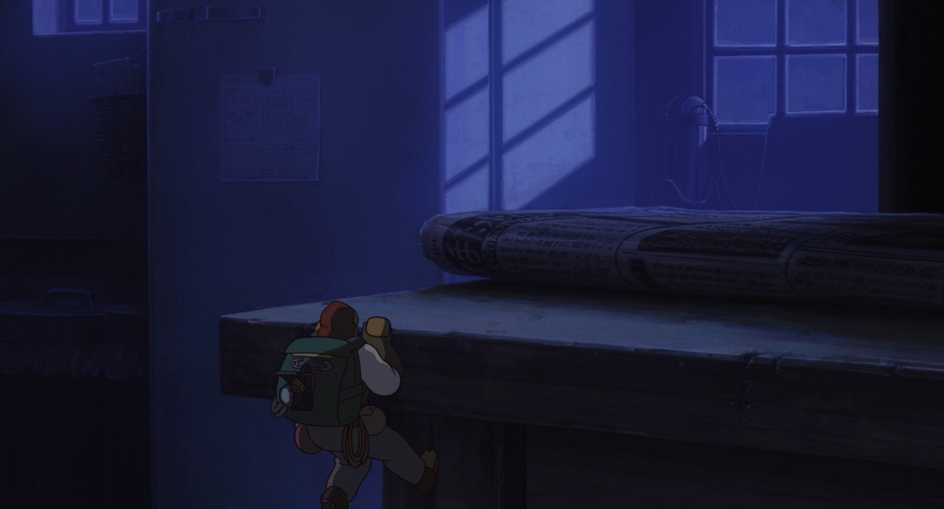
The Intro
Life isn’t easy for Eddy - an ant-sized human - as he has to
live in a big world, hiding from ordinary humans, yet living
amongst them.

Slide 4
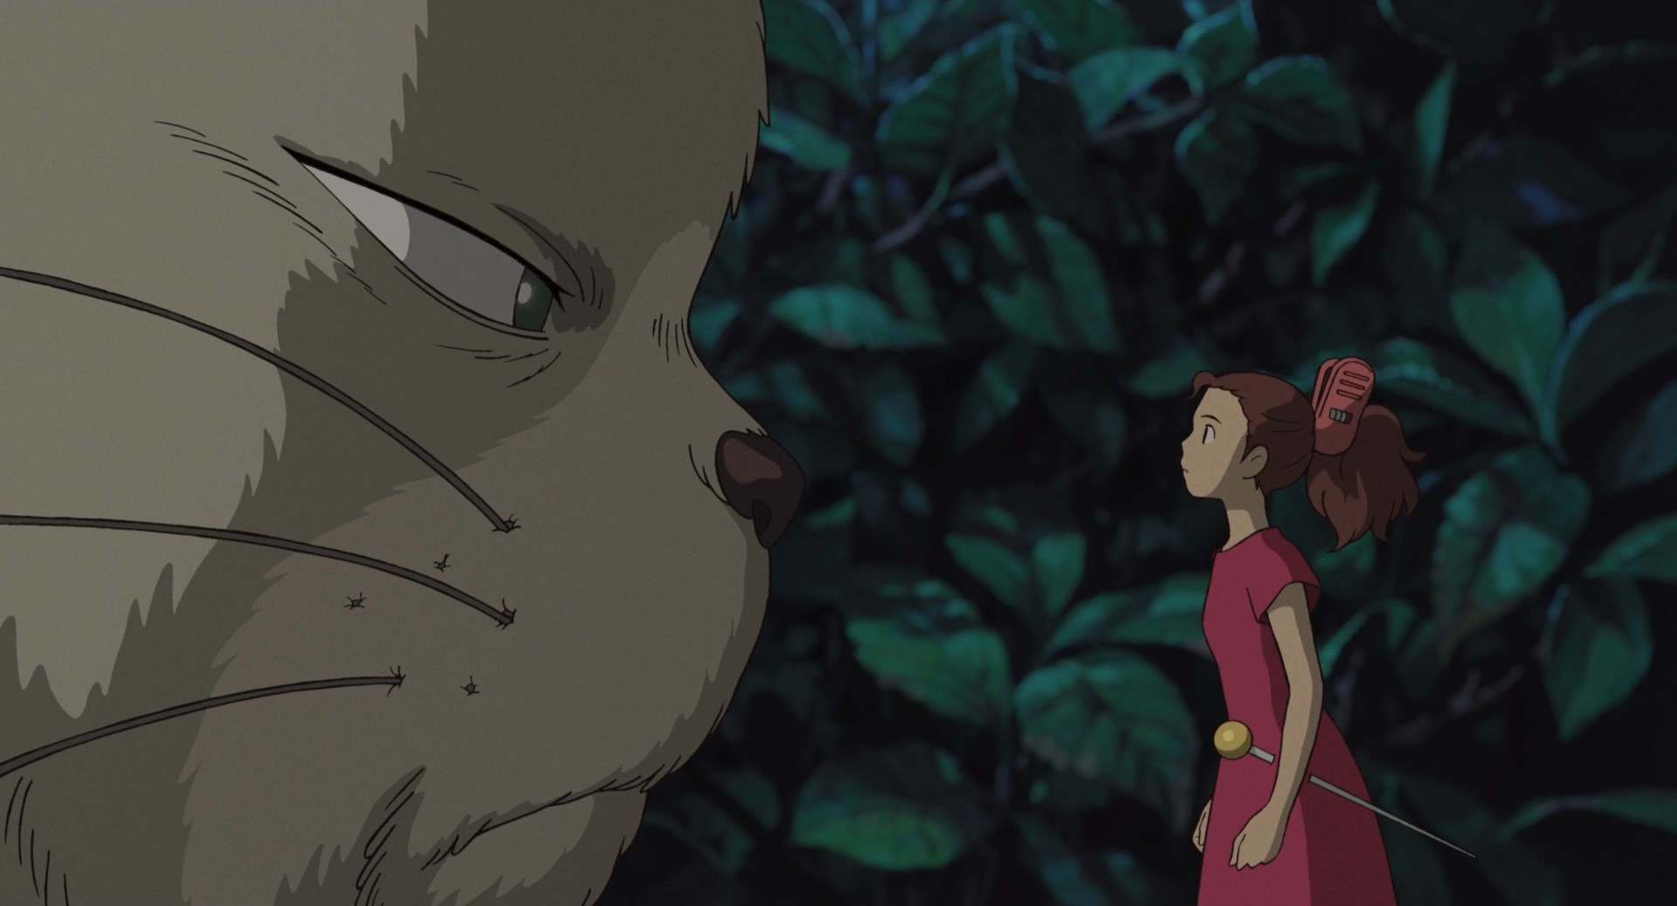
The Intro
You play as Eddy, living out his everyday life, scavenging
for food in an ordinary household, all the while avoiding
humans and other threats.

Slide 5


The Game
Genre
First Person RPG, Puzzle, Stealth
Target platform
Microsoft Windows
Distribution platform
Steam

Slide 6
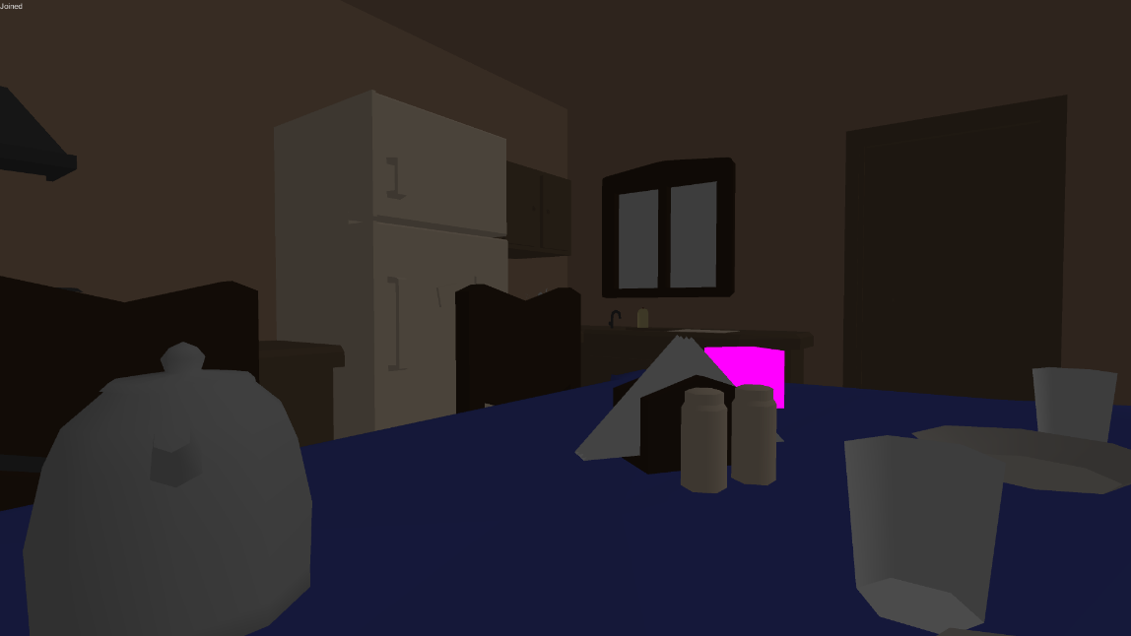
The Game
Follow through objectives
Open-world approach
Suitable for all ages

Slide 7
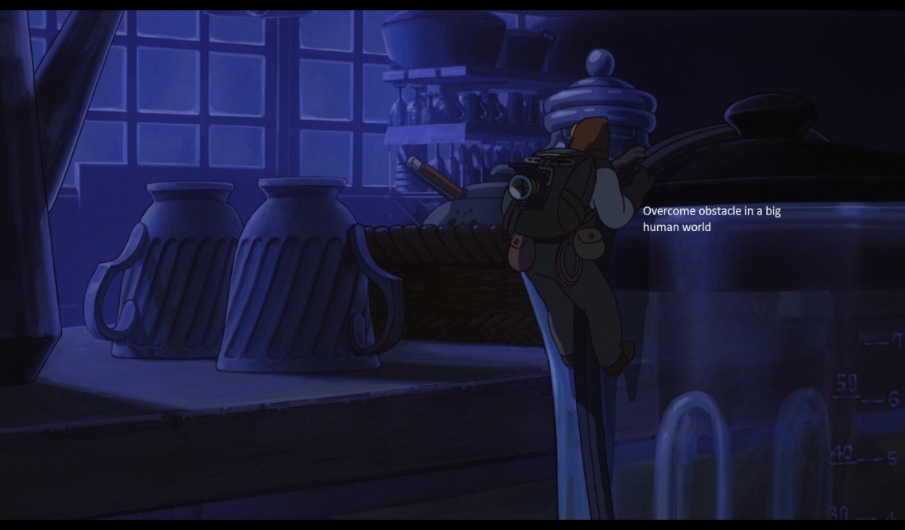
Game Concept
Navigate around the house as a tiny human
Players are given objectives
helps them reach their goal
up to players on how they want to clear an objective
Craft and utilize objects found along the way
Overcome obstacles to reach the goal
Inspired by the film, “The Borrower Arrietty”

Slide 8
Game Logic
Game Scenario Example
Goal
Reach the cupboard which is across the room
Objectives
1) Distract the sleeping cat who’s in your way
2) Find your way to the top

Slide 9
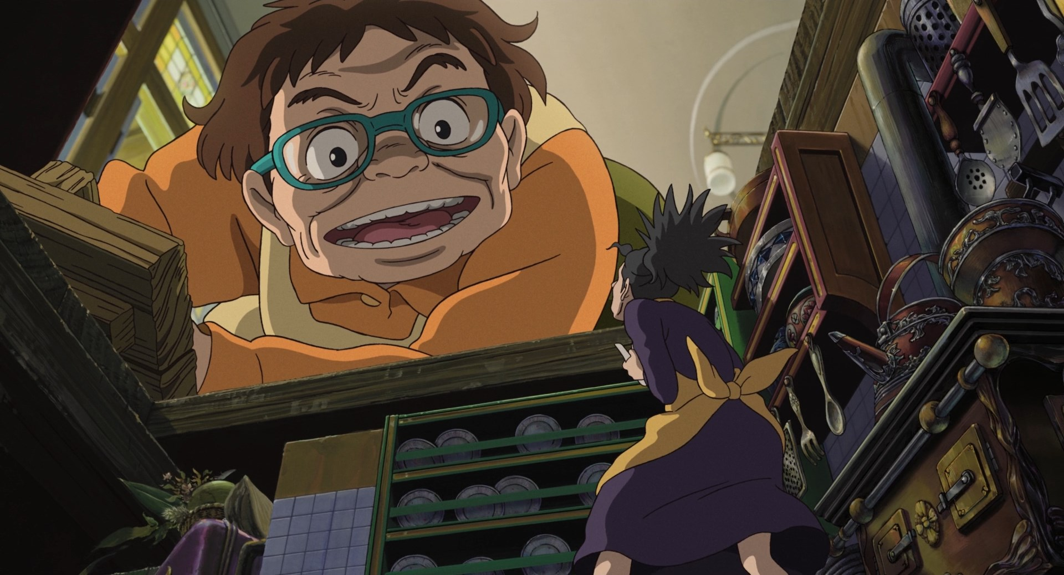
Game Logic
Making loud noises or getting spotted will alarm humans/pets
players may get attacked and killed
Falling from a great height would also kill you

Slide 10
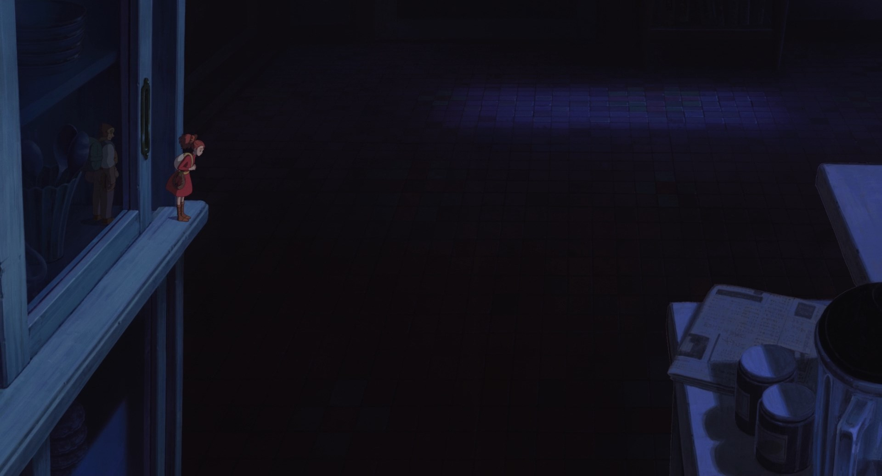
The USPs
Uncommon perspective for player (role playing as little creature)
Stealth, puzzle game in a house
Various ways to achieve tasks
Familiar world setting, allowing easier immersion

Slide 11
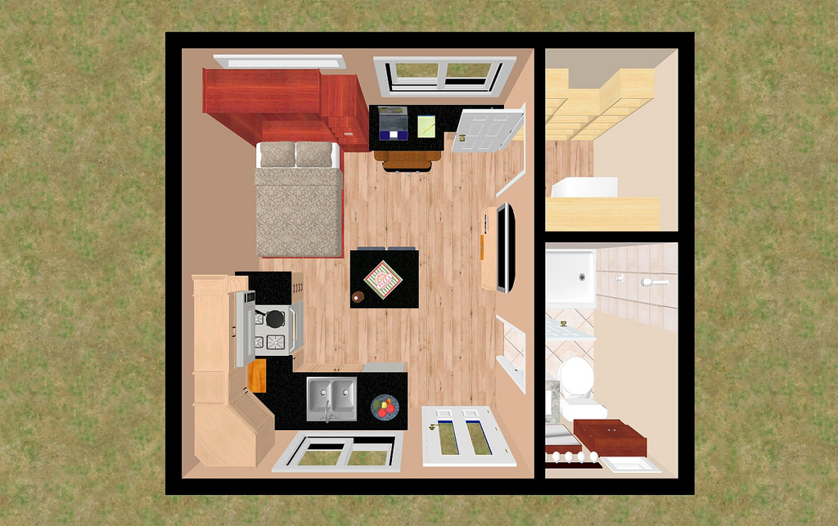
Level Design Concept

Slide 12
Level Design
Game divided into ‘Chapters’
Each chapter takes place in a part of the house
Upon completing a goal in a chapter, players would unlock and move on to the following chapter
First chapter shows players the ropes

Slide 13
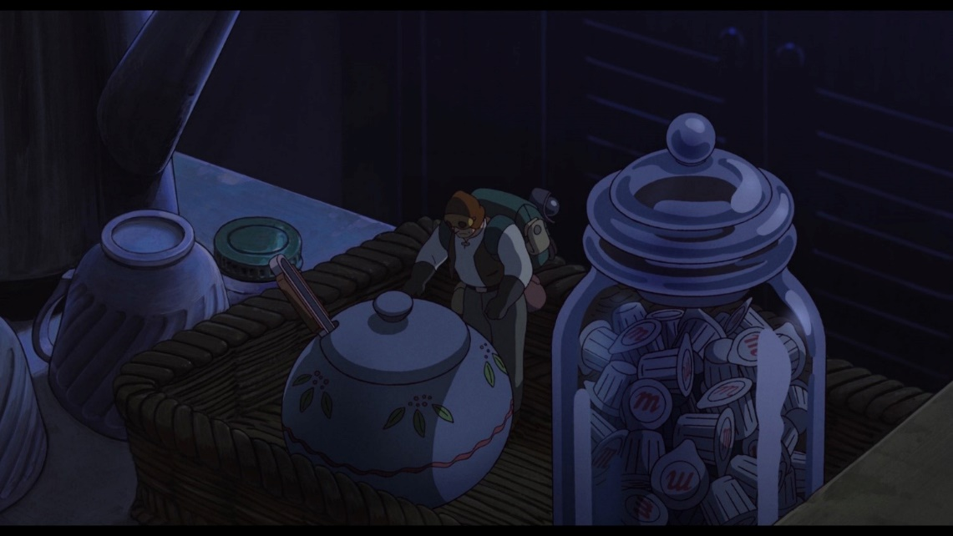
Level Design
Planned Goals
Creating of tools (e.g. grappling hook, parachute, etc.)
Reaching to food storage location (e.g. fridge/cupboards)
Retrieving of food to Eddy’s home
“Retrieving sugar”

Slide 14
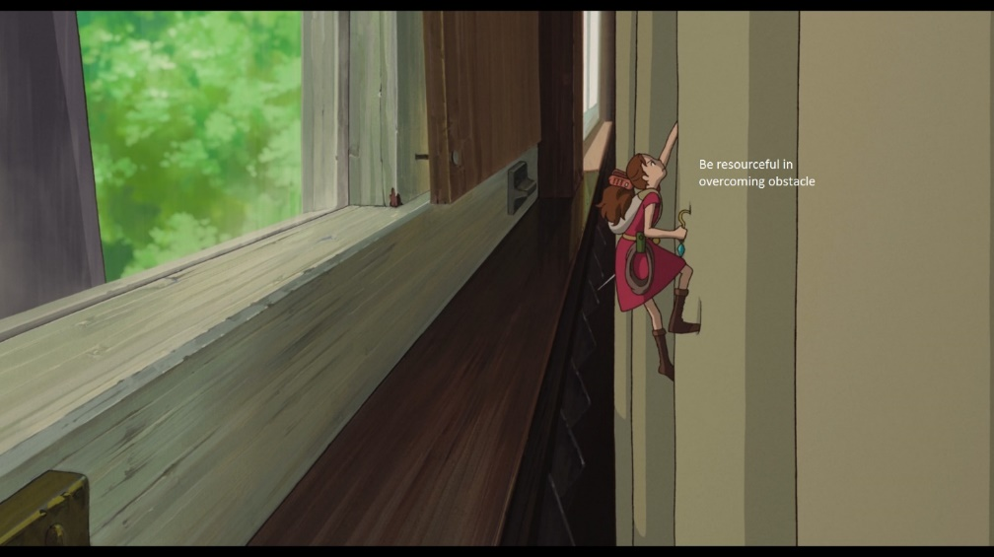
The Intention
Stimulate a unique perspective for players
Promote player’s creativity & resourcefulness on their approach to the objectives
Promote concentration & calmness by letting player walk on a tightrope, surviving while completing tasks
Promote awareness of how small human is to the world
“Resourcefulness in overcoming obstacles”

Slide 15
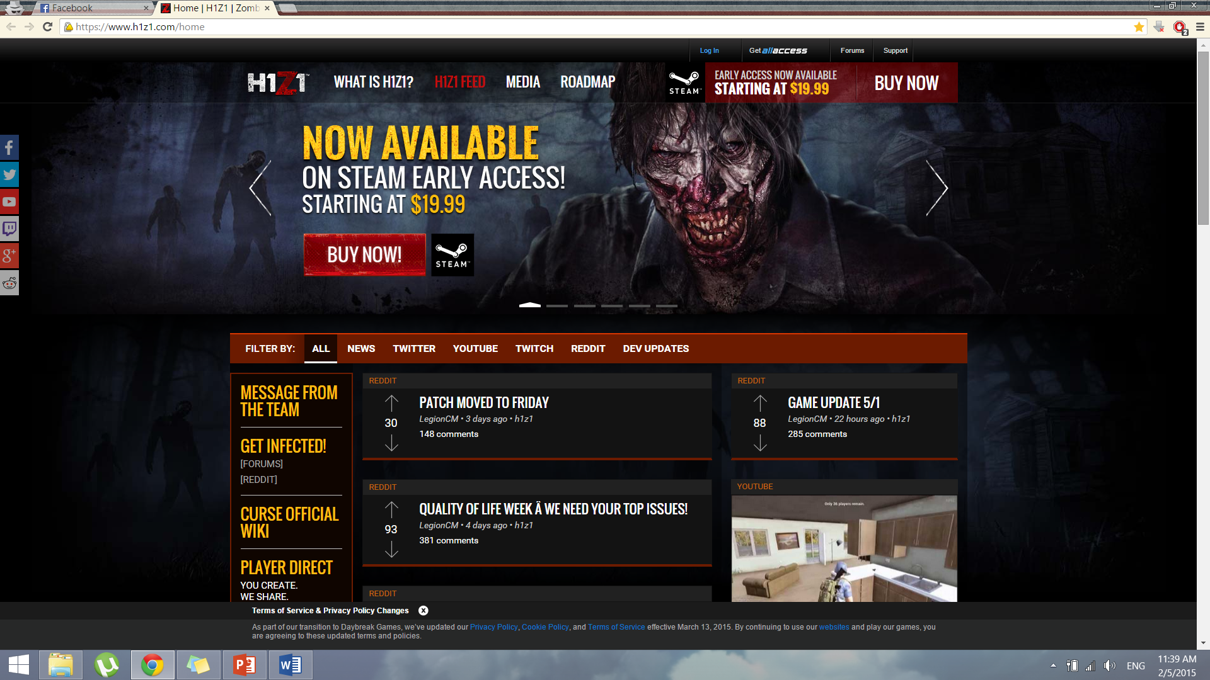


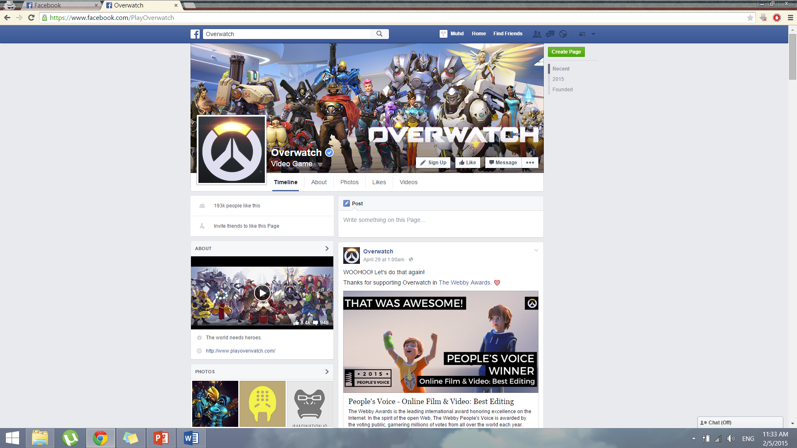

Advertising Strategies
Social Media Connect
Kickstarter/crowdfunding
Official webpage/development blogs/ fb page
Steam Greenlight?

Slide 16


Monetization Strategies
DLC Chapters
Soundtrack download
Inclusion of advertiser’s product as game object
Sponsor page with links

Slide 17
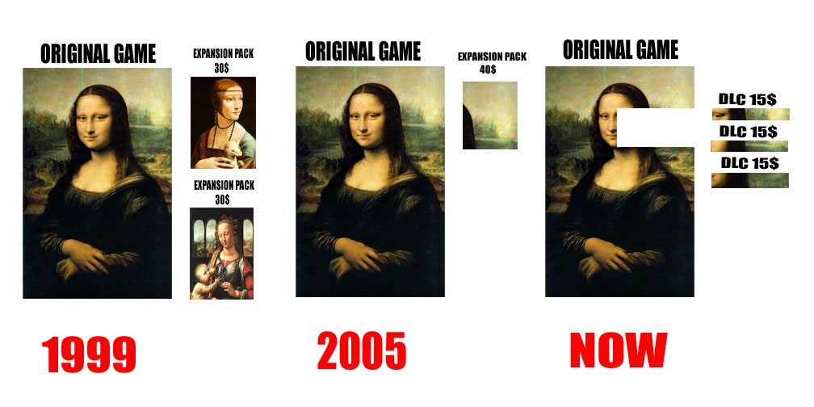
Retention Strategies
Release DLC biannually

Slide 18
Production Milestones
Week 1 (21 Apr) | Week 2 (28 Apr) | Week 3 (5 May) | Week 4 (12 May) | Week 5 (19 May) | Week 6 (26 May) | Week 7 (2 Jun) | Week 8 (9 Jun) Term break | Week 9 (16 Jun) Term break
 | Game idea, game design (pitching) | Framework, basic features | Level 1, basic UI, some game elements | AI, win & lose condition, basic gameplay | Adding rest of the levels | Adding rest of the game elements, crafting system | Adding rest of the game elements, crafting system | Mini map, sounds, music, menus/screen pages
Week 10 (23 Jun) | Week 11 (30 Jun) | Week 12 (7 Jul) | Week 13 (14 Jul) | Week 14 (21 Jul) | Week 15 (28 Jul) | Week 16 (4 Aug) | Week 17 (11 Aug)
Polishing up levels and UI | Playtest, fix bugs | Playtest, fix bugs | Balancing game, fix bugs | Balancing game, fix bugs | Final polish and check | Final presentation | Review

Slide 19
Q& A

